Slide 1

Background Services with Kubernetes as an alternative to use data processes
The background services are those services available for processing data in async mode and easy to administrate
Juan Felipe Quintana Gómez
Senior Software Engenieer in .NET

Slide 2
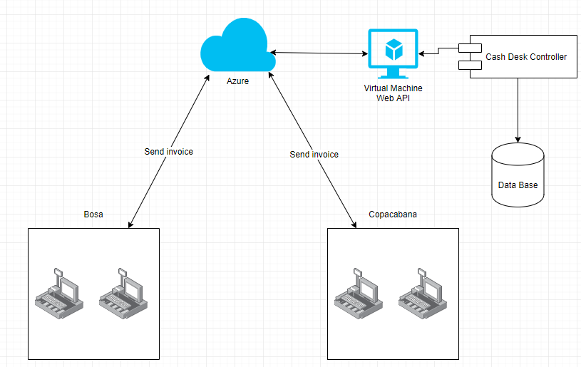

Slide 3
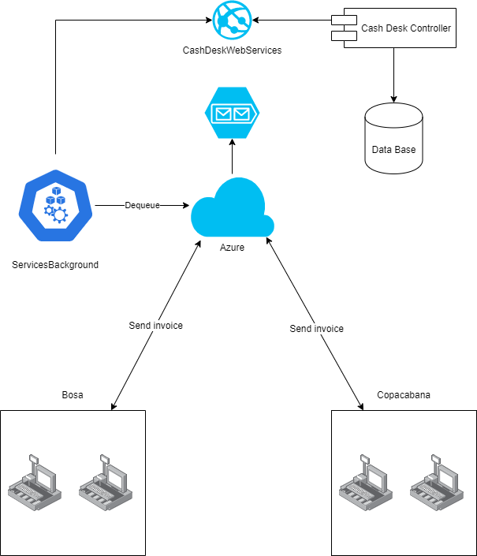

Slide 4
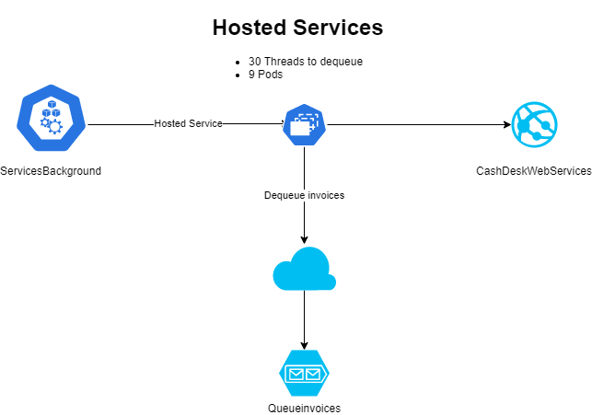

Slide 5
https://bit.ly/38DJ8r8

